Slide 1
Automation Testing

Slide 2
Framework-
Java
Selenium
TestNG
POM
Maven
Extent Report

Slide 3
Why to do Automation Testing?
100% Test Coverage.
Speed Execution.
Enhanced Results.
Efficiency Testing.
Detailed Testing.
Reusability.

Slide 4
Results / Output
HTML interactive file.
All test results on one page.
View ‘Passed / Failed / Skipped’ Test Cases.
Percentage of Pass to Fail.

Slide 5
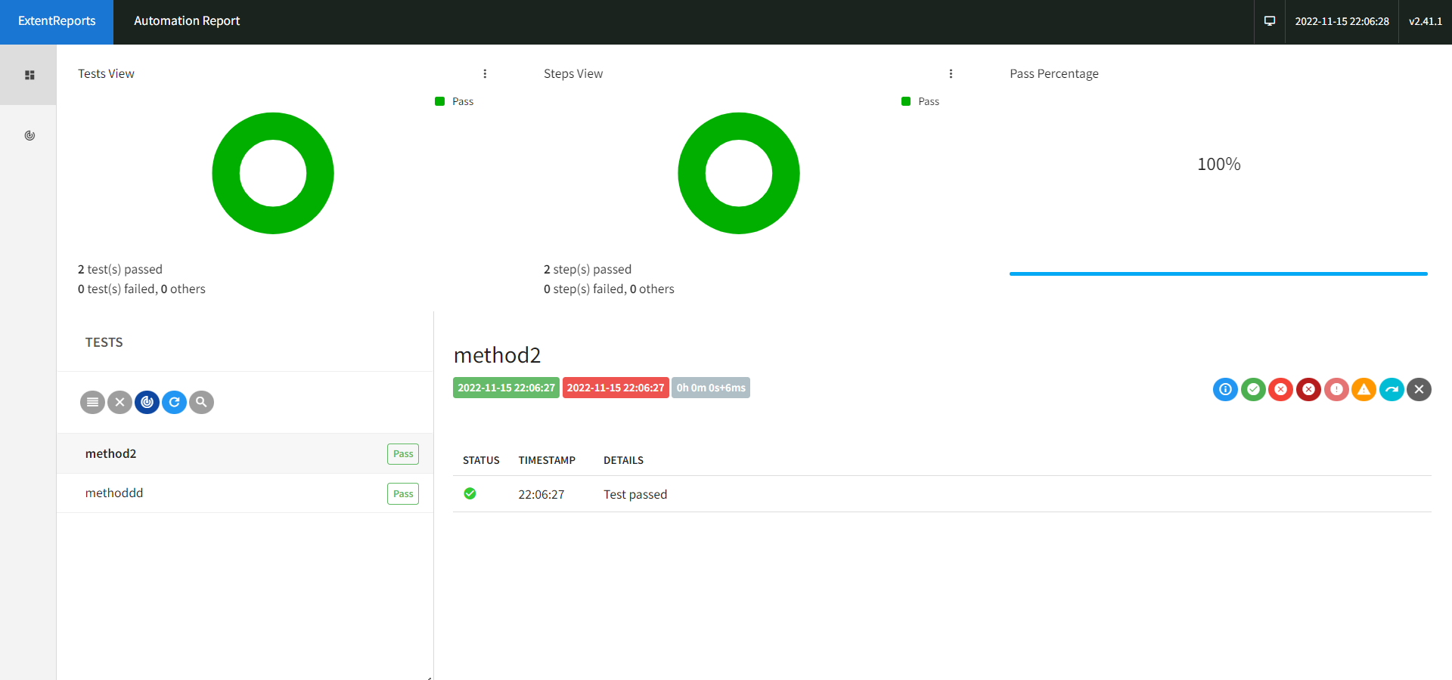
Automation Report

Slide 6
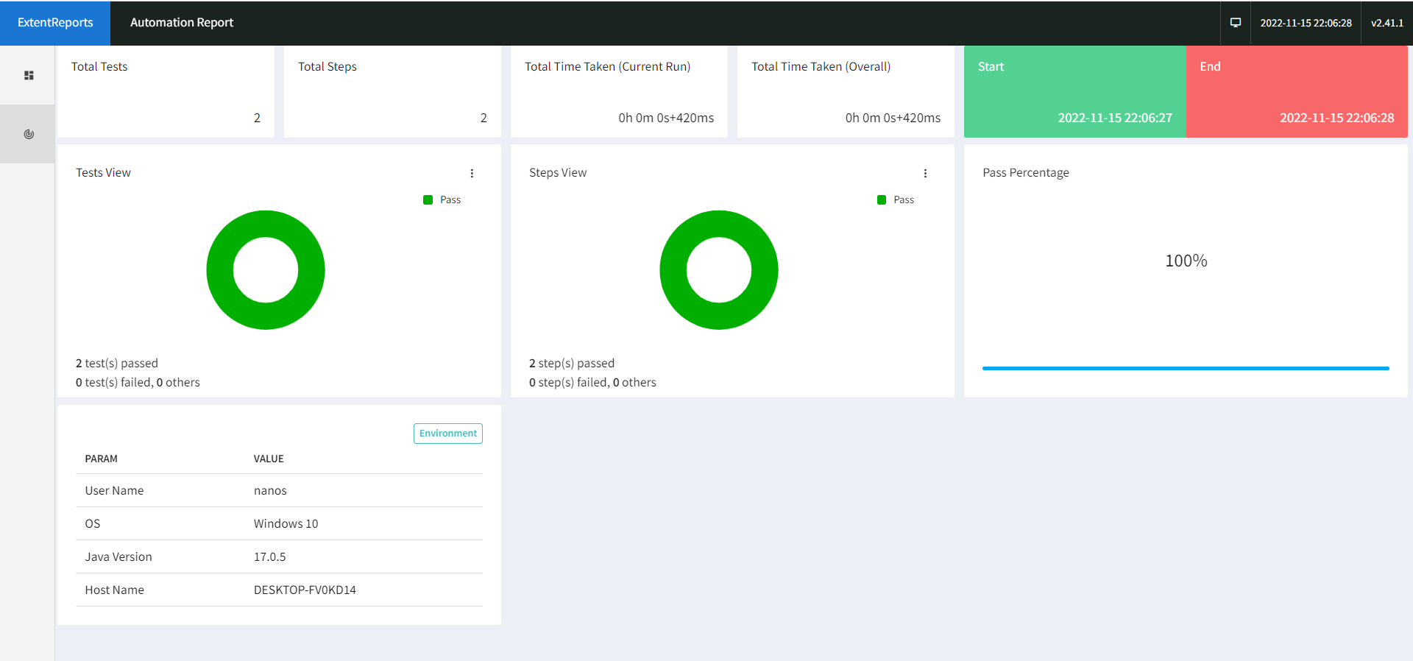
Automation Report

